Slide 1
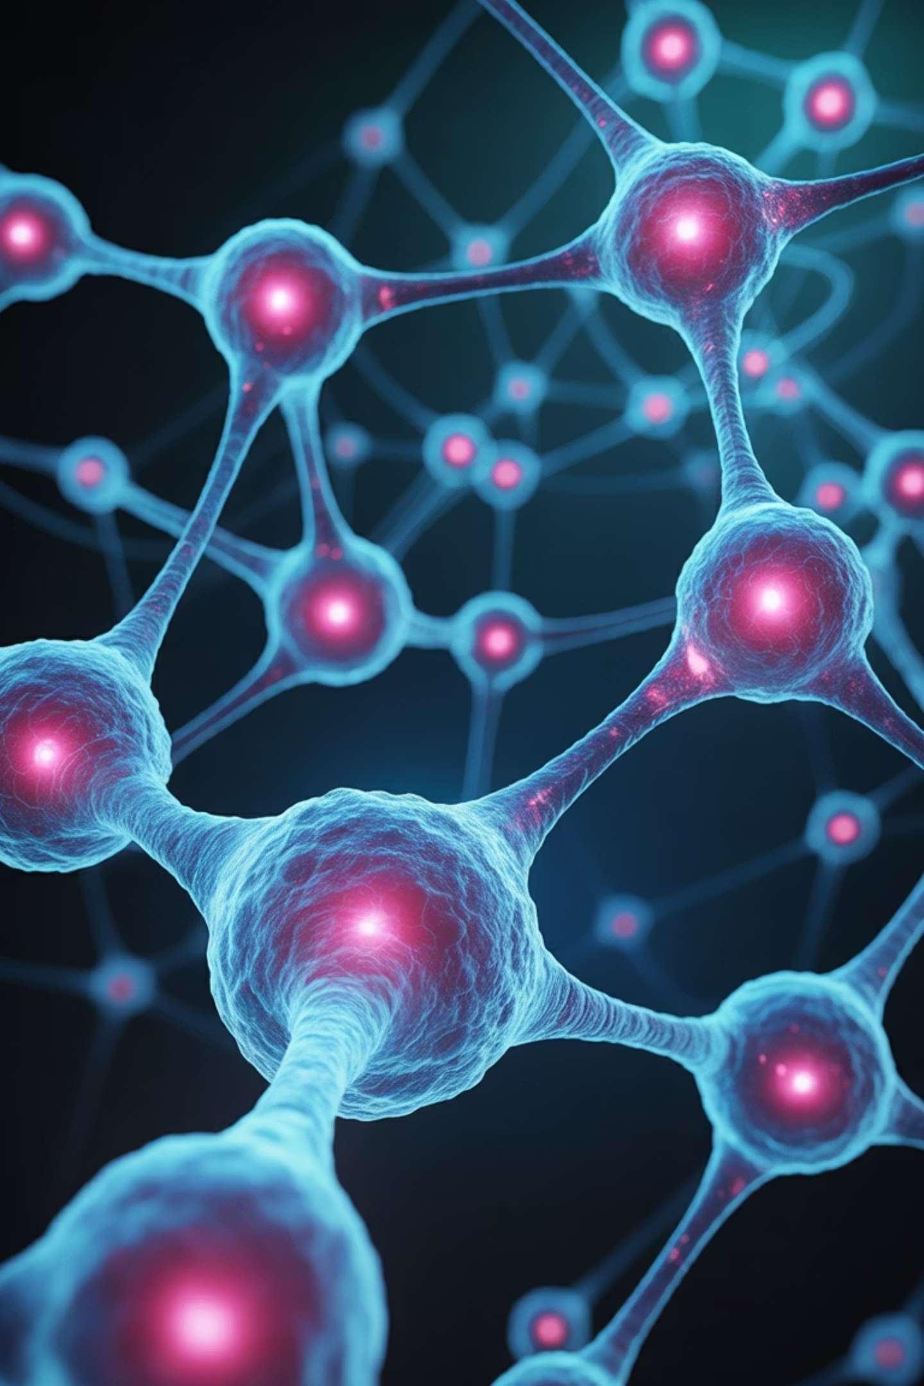
Systems Biology: Understanding Life as a Network
Systems biology is an integrated approach to understanding biological systems as a whole network rather than isolated parts. The goal is to model and analyze how genes, proteins, and metabolites interact to maintain life processes.
"The whole is greater than the sum of its parts."

Slide 2







Applications of Systems Biology
Drug Discovery
Disease Modeling
Accelerating the development of new therapeutics through metabolic engineering and pathway analysis.
Understanding complex disease mechanisms by mapping biological pathways and interactions.
Synthetic Biology
Integrating bioinformatics to design and engineer novel biological systems and functions.

Slide 3
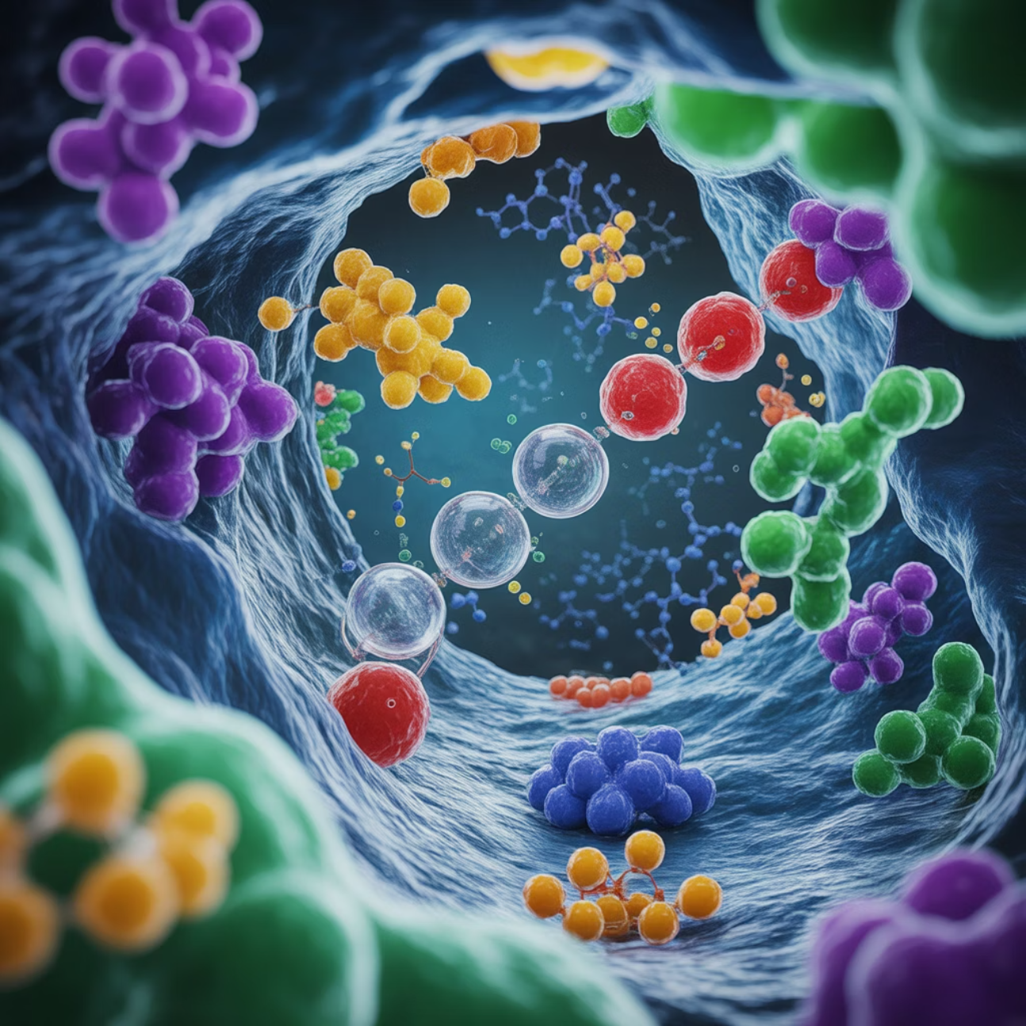
What are Metabolic Pathways?
A metabolic pathway is a series of enzyme-catalyzed biochemical reactions in cells that convert substrates into products. These pathways are highly regulated, interconnected, and use shared intermediates with sophisticated feedback control mechanisms.
Key Characteristics
Highly regulated and interconnected networks
Share common intermediates across pathways
Exhibit precise feedback control mechanisms
Essential for maintaining cellular homeostasis

Slide 4
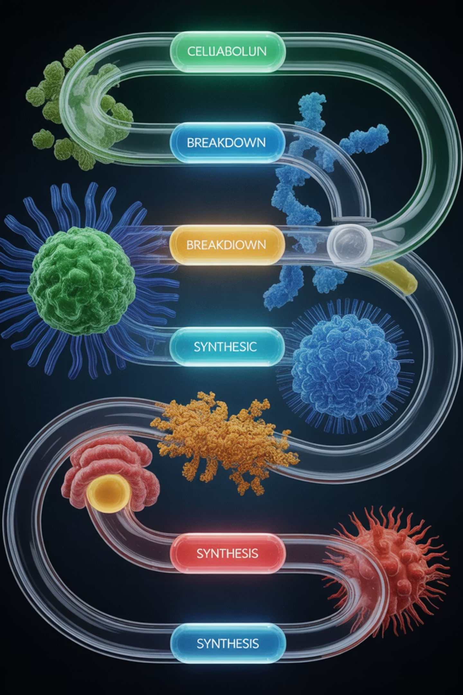
Two Types of Metabolic Pathways
Catabolic Pathways
Break down complex molecules to release energy that cells can use for various processes.
Example: Glycolysis breaks down glucose into pyruvate, generating ATP and NADH for cellular energy.
Anabolic Pathways
Synthesize complex molecules from simpler building blocks, requiring energy input.
Example: Amino acid synthesis builds proteins from basic molecular components.

Slide 5
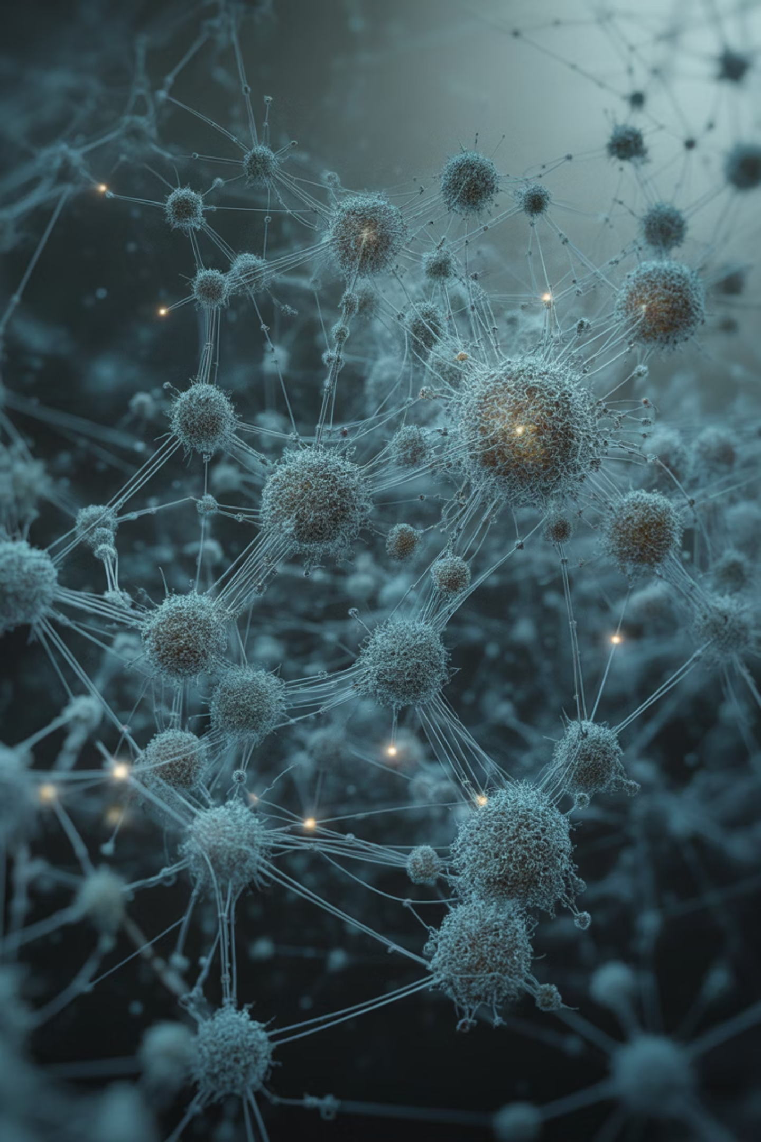


From Linear Pathways to Networks
Traditional biochemistry treated pathways like glycolysis and the TCA cycle as separate, linear sequences. Systems biology revolutionizes this view by recognizing that all pathways are interconnected networks forming a comprehensive metabolic network map.
Traditional View
Isolated linear pathways studied independently
Systems Biology View
Interconnected metabolic network maps

Slide 6
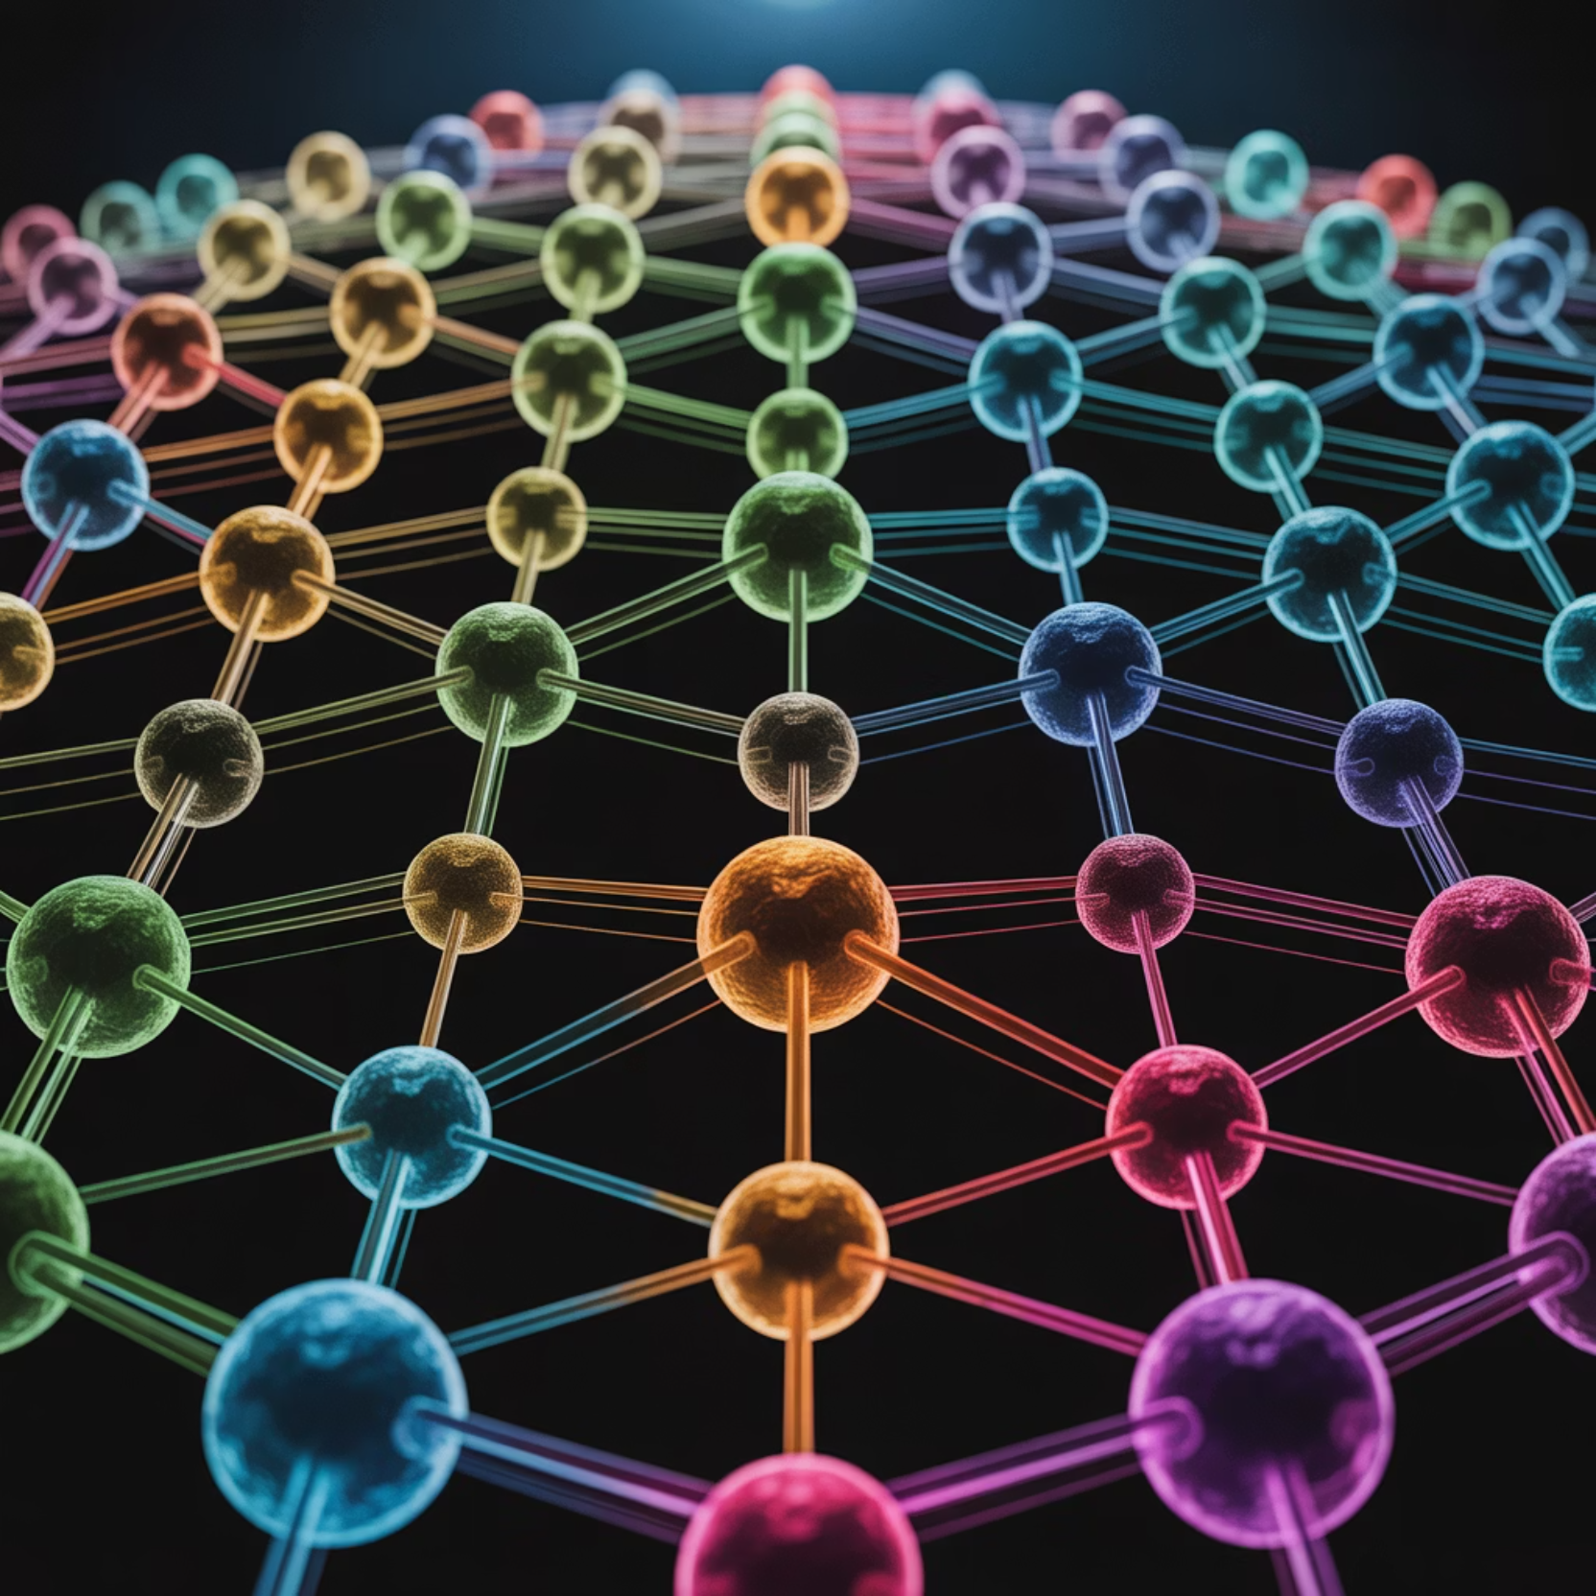
Understanding Network Topology
Network Components
Nodes: Individual metabolites in the system
Edges: Enzymatic reactions connecting metabolites
Key Features
Hubs: Critical metabolites like ATP and NADH that connect multiple reactions throughout the network.
Modules: Functional clusters such as lipid metabolism or amino acid biosynthesis that work together.

Slide 7
High-Throughput Omics Data
Integration of multiple omics datasets helps create a comprehensive model of metabolism, providing insights at every biological level.
Type
Focus
Example
Genomics
Genes encoding metabolic enzymes
DNA sequencing
Transcriptomics
mRNA levels
RNA-Seq
Proteomics
Enzyme abundance
2D gels, Mass spectrometry
Metabolomics
Metabolite concentration
LC-MS, NMR

Slide 8
Computational Modeling Approaches
01
02
03
Stoichiometric Models
Kinetic Models
Dynamic Systems Modeling
Constraint-based models using reaction stoichiometry. Flux Balance Analysis (FBA) predicts metabolic flux distribution across the network.
Include reaction rates and enzyme kinetics with Michaelis-Menten parameters, useful for dynamic simulations of metabolic behavior.
Uses differential equations to describe time-dependent changes in metabolite concentrations throughout the system.

Slide 9





Key Concepts in Metabolic Systems Modeling
Flux
Flux Balance Analysis
Gene Knockout Simulation
Rate of flow of metabolites through a pathway, measuring how quickly substrates are converted to products.
Predicts optimal growth or production rates using constraints like nutrient limits and thermodynamic feasibility.
Predicts the effect of removing a gene or enzyme on overall metabolism and cellular function.
Network Robustness
Control Coefficients
Ability of the system to maintain function despite perturbations or environmental changes.
Quantify how changes in enzyme activity affect metabolic flux through specific pathways.

Slide 10





Essential Pathway Databases
KEGG
BioCyc / MetaCyc
Kyoto Encyclopedia of Genes and Genomes provides comprehensive metabolic maps and enzyme links for multiple organisms.
Curated pathway data with detailed information about metabolic reactions and their regulation.
Reactome
Comprehensive database of human biological pathways with detailed molecular interactions and disease associations.

Slide 11

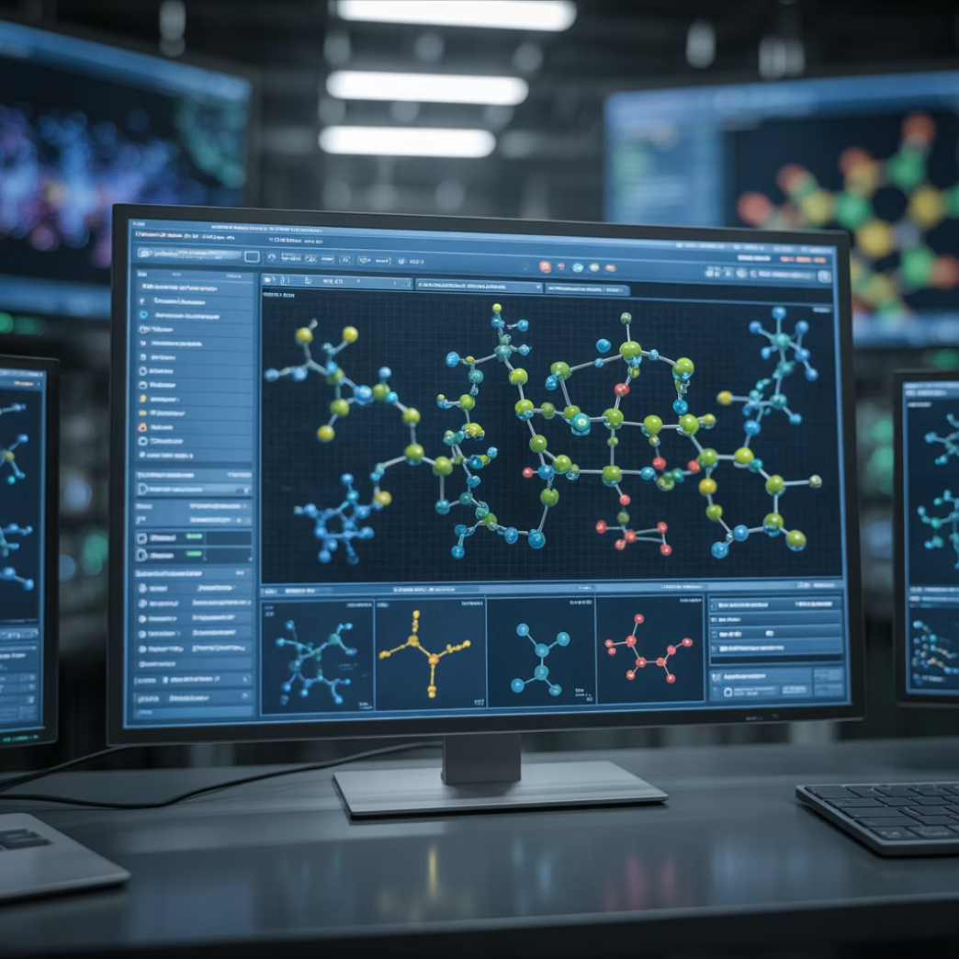
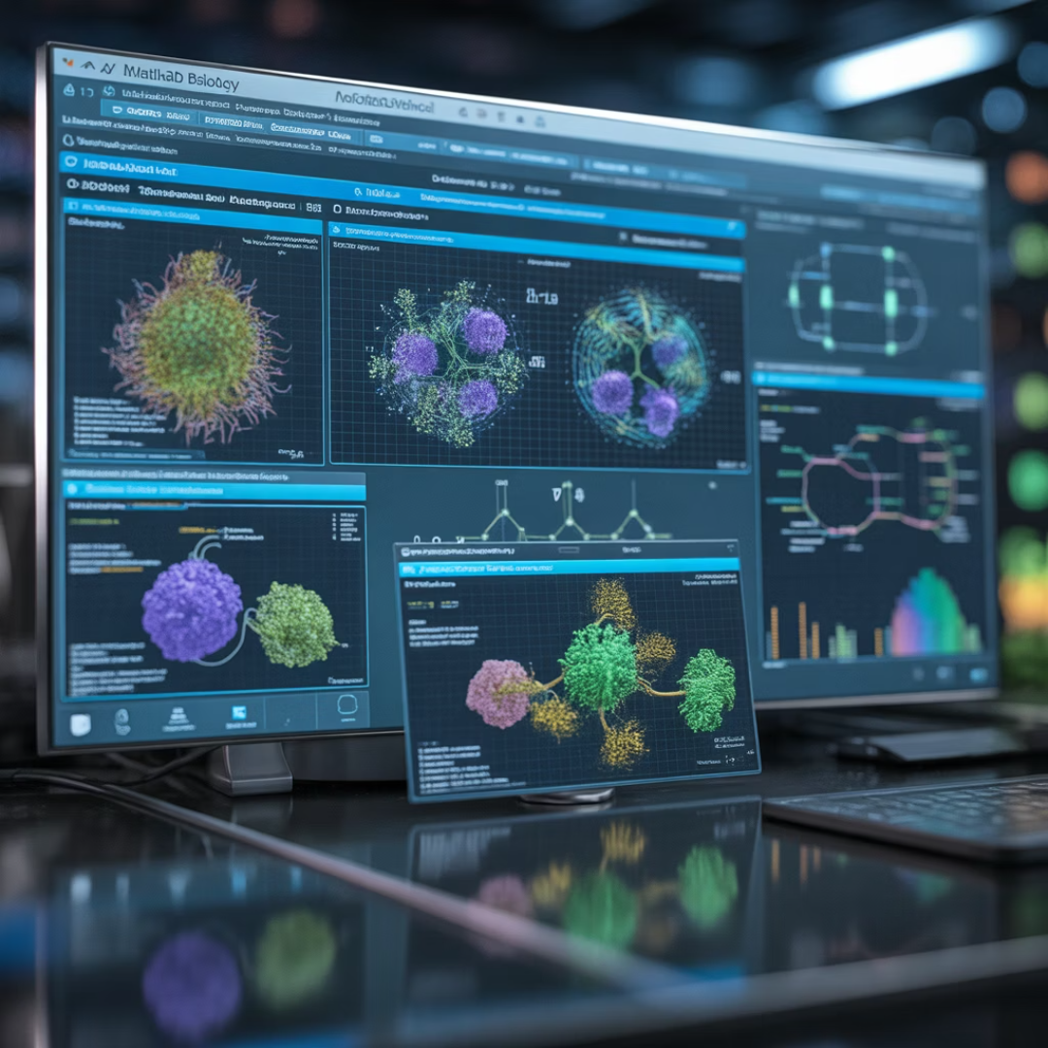
Visualization Tools
COBRA Toolbox
(COnstraints-Based
Reconstruction and Analysis)
Cytoscape
CellDesigner
Powerful platform for visualizing and analyzing complex network interactions and relationships.
Specialized tool for drawing and modeling biochemical networks with standardized notation.
MATLAB-based suite for performing Flux Balance Analysis and constraint-based modeling.

Slide 12
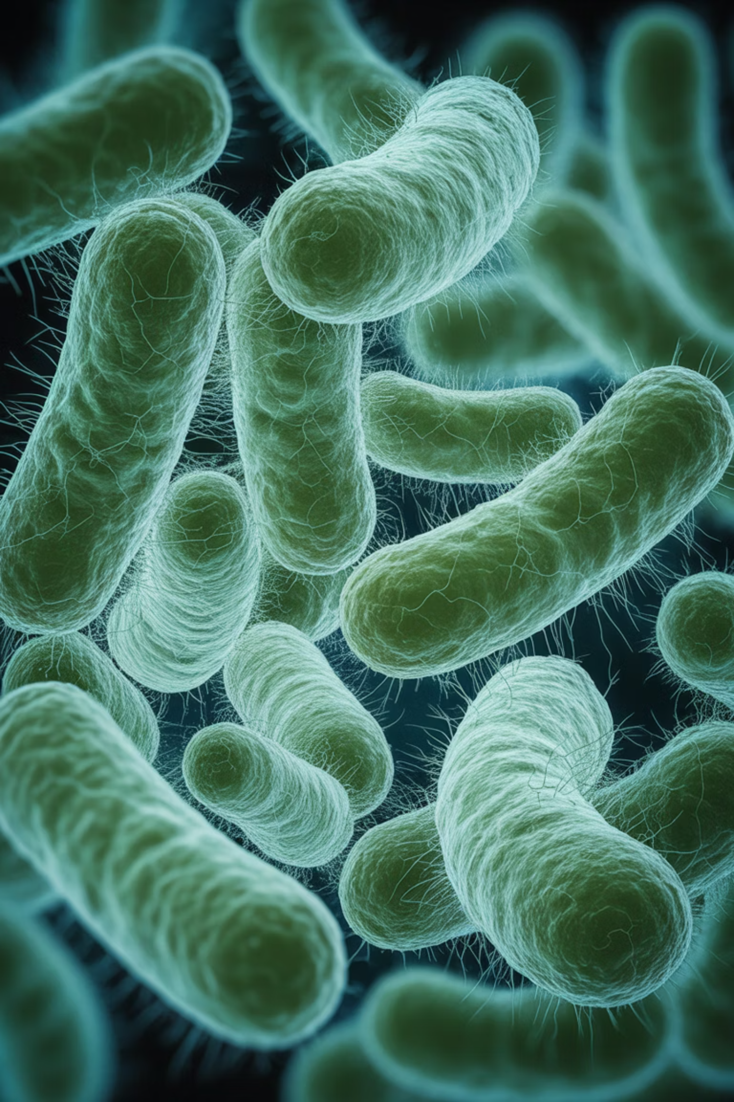
Case Study: E. coli Metabolic Network
The E. coli metabolic network reconstruction represents a landmark achievement in systems biology, integrating genomics and metabolomics data to predict bacterial growth under diverse environmental conditions.
Integration
Prediction
Combined genomic sequences with metabolomic measurements to build comprehensive models
Accurately forecasts growth rates and metabolic behavior under various nutrient conditions
Application
Used extensively in optimizing industrial fermentation processes for biotechnology

Slide 13
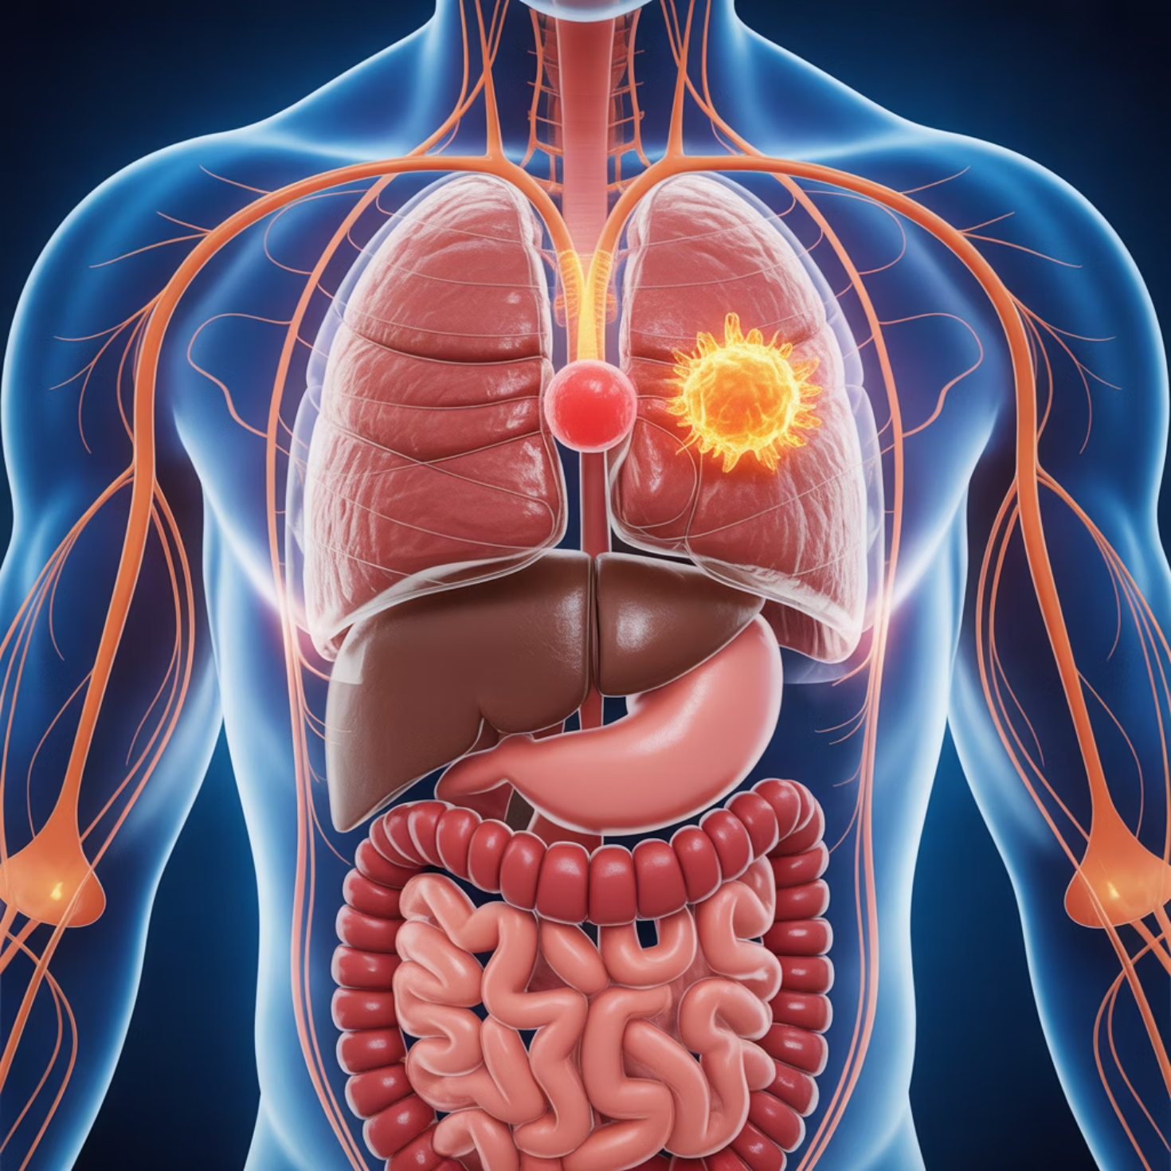
Human Metabolic Network: Recon3D
The human metabolic network reconstruction, known as Recon3D, represents the most comprehensive map of human metabolism to date.
Key Applications
Studying disease metabolism and metabolic disorders
Identifying potential drug targets for therapeutic intervention
Understanding personalized medicine approaches
Predicting metabolic responses to dietary changes

Slide 14
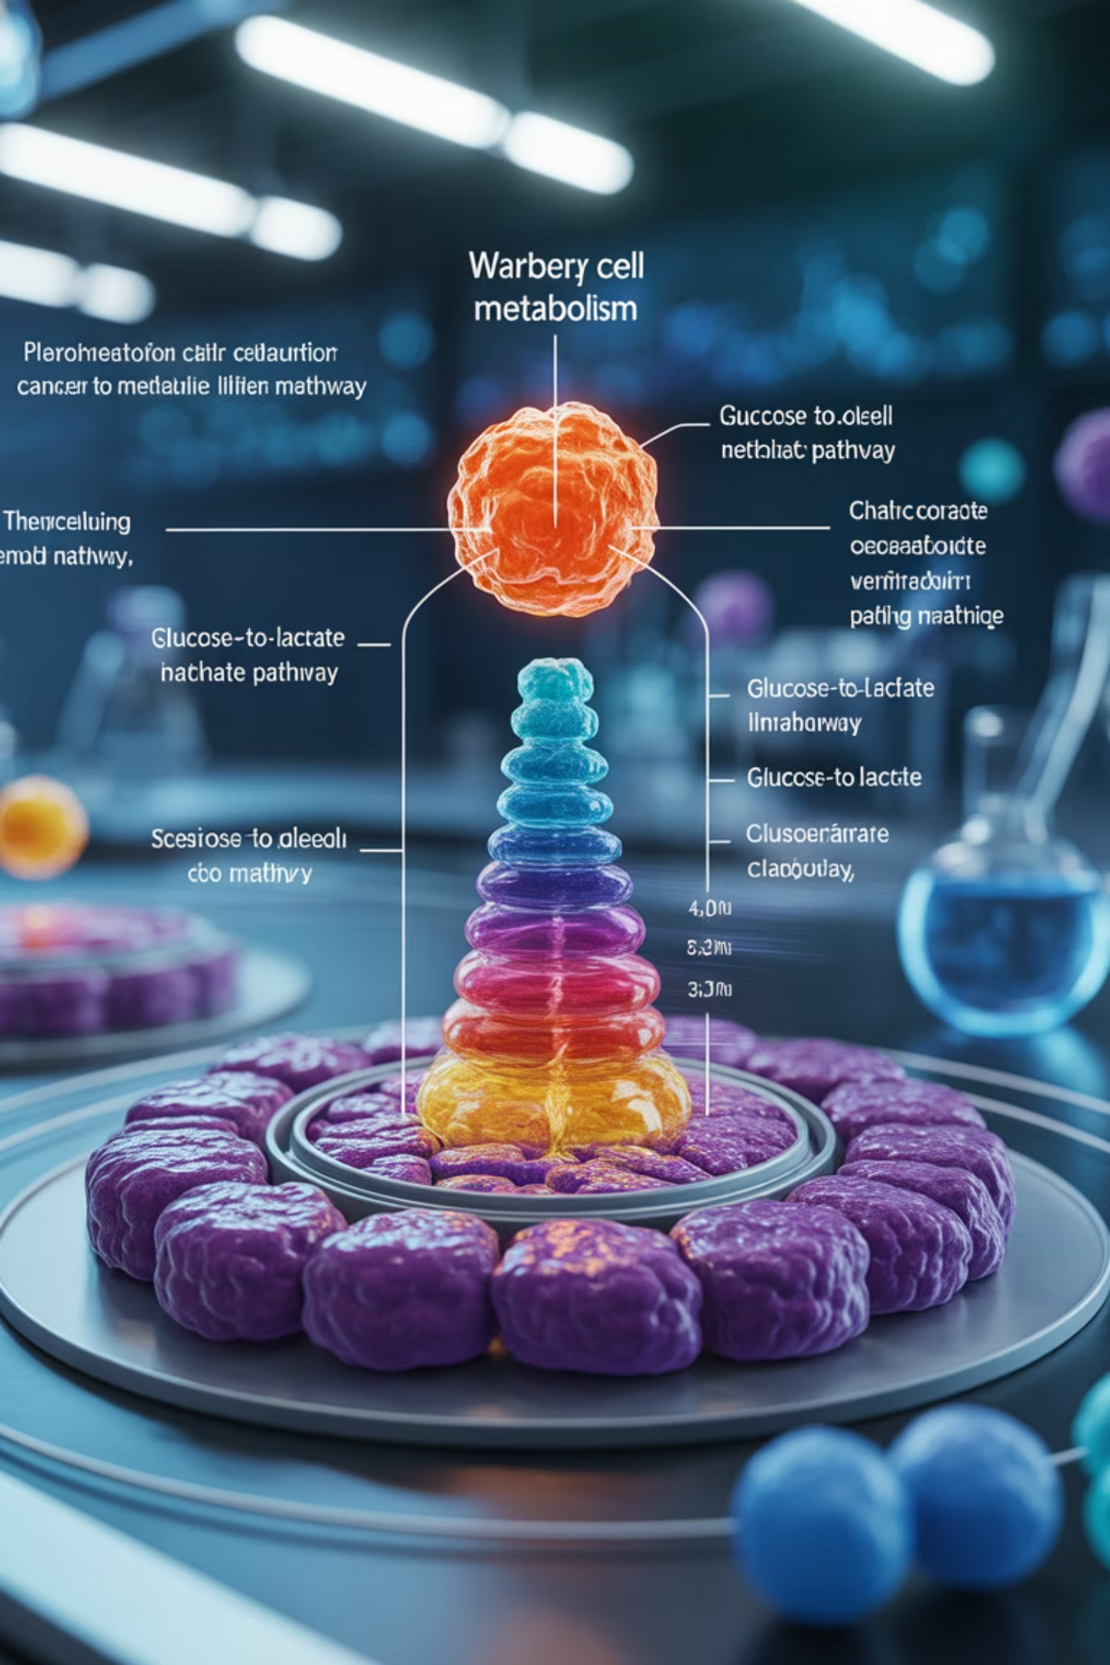
Cancer Metabolism: The Warburg Effect
Systems biology models have revealed critical insights into cancer metabolism, particularly the Warburg effect – a metabolic shift from oxidative phosphorylation to glycolysis even in the presence of oxygen.
1
Normal Cells
Use oxidative phosphorylation for efficient ATP production
2
Metabolic Shift
Cancer cells switch to glycolysis despite oxygen availability
3
Therapeutic Target
Understanding this shift enables development of targeted cancer therapies

Slide 15
Applications in Metabolic Engineering
Systems biology enables precise modification of metabolic pathways to produce valuable compounds including biofuels, antibiotics, and bioplastics.
Biofuels
Antibiotics
Bioplastics
Engineering microorganisms to efficiently convert biomass into sustainable fuel alternatives.
Optimizing biosynthetic pathways for increased production of life-saving medications.
Creating environmentally friendly alternatives to petroleum-based plastics.

Slide 16








Disease Modeling Applications
Diabetes
Obesity
Understanding glucose metabolism dysfunction and insulin resistance pathways
Modeling lipid metabolism and energy balance disruptions
Cardiovascular Disease
Cancer
Studying cholesterol and lipid metabolism abnormalities
Analyzing altered metabolic pathways that support tumor growth
Systems biology provides powerful frameworks for understanding metabolic dysfunction in complex diseases, enabling development of targeted therapeutic strategies.

Slide 17
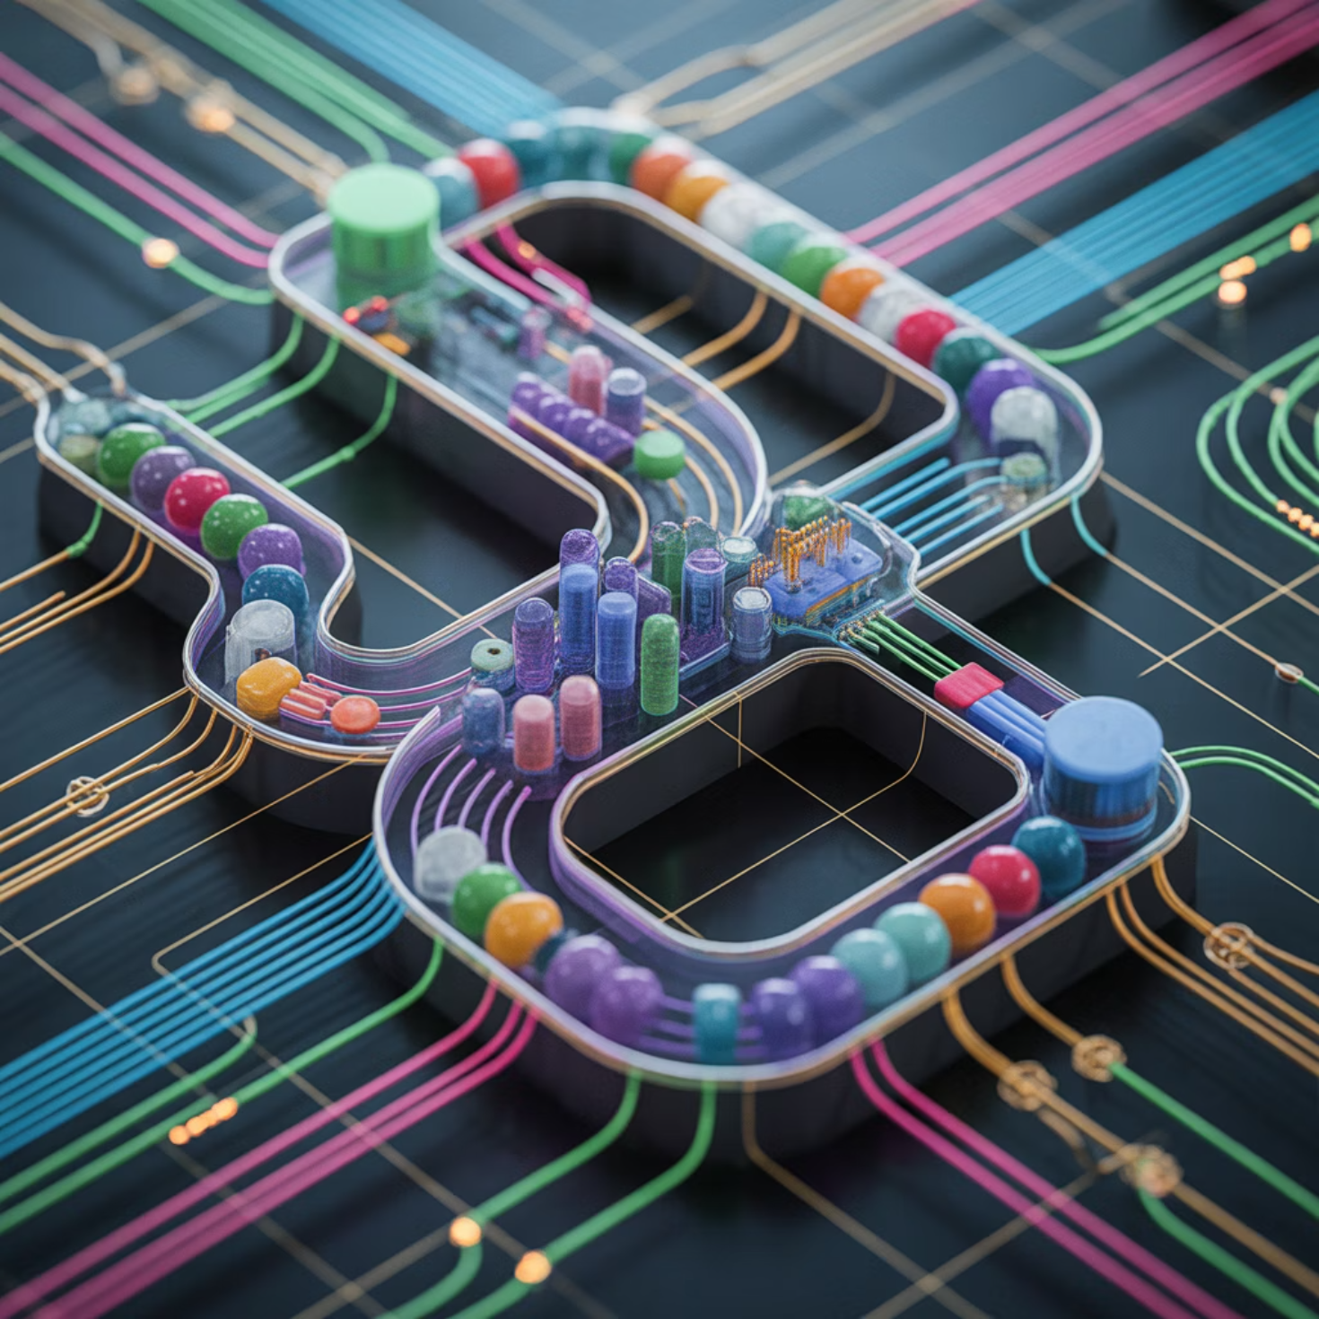
Synthetic Biology: Designing New Circuits
Systems biology principles enable the design of artificial metabolic circuits for novel biochemical production. This emerging field combines engineering principles with biological systems to create entirely new metabolic capabilities.
Key Capabilities
Design custom biosynthetic pathways
Create novel enzyme combinations
Optimize production of valuable compounds
Engineer biological sensors and switches

Slide 18
Advantages and Challenges
Advantages
Challenges
Integrative Power
Data Integration
Combines multiple data types for comprehensive understanding
Complex omics data requires sophisticated analysis
Predictive Capability
Parameter Gaps
Enables accurate forecasting of system behavior
Incomplete kinetic parameters limit model accuracy
In Silico Testing
Computational Limits
Allows virtual experimentation before lab work
Large networks demand significant computing power
Cost Efficiency
Model Validation
Reduces time and expenses in research
Experimental verification remains essential

Slide 19
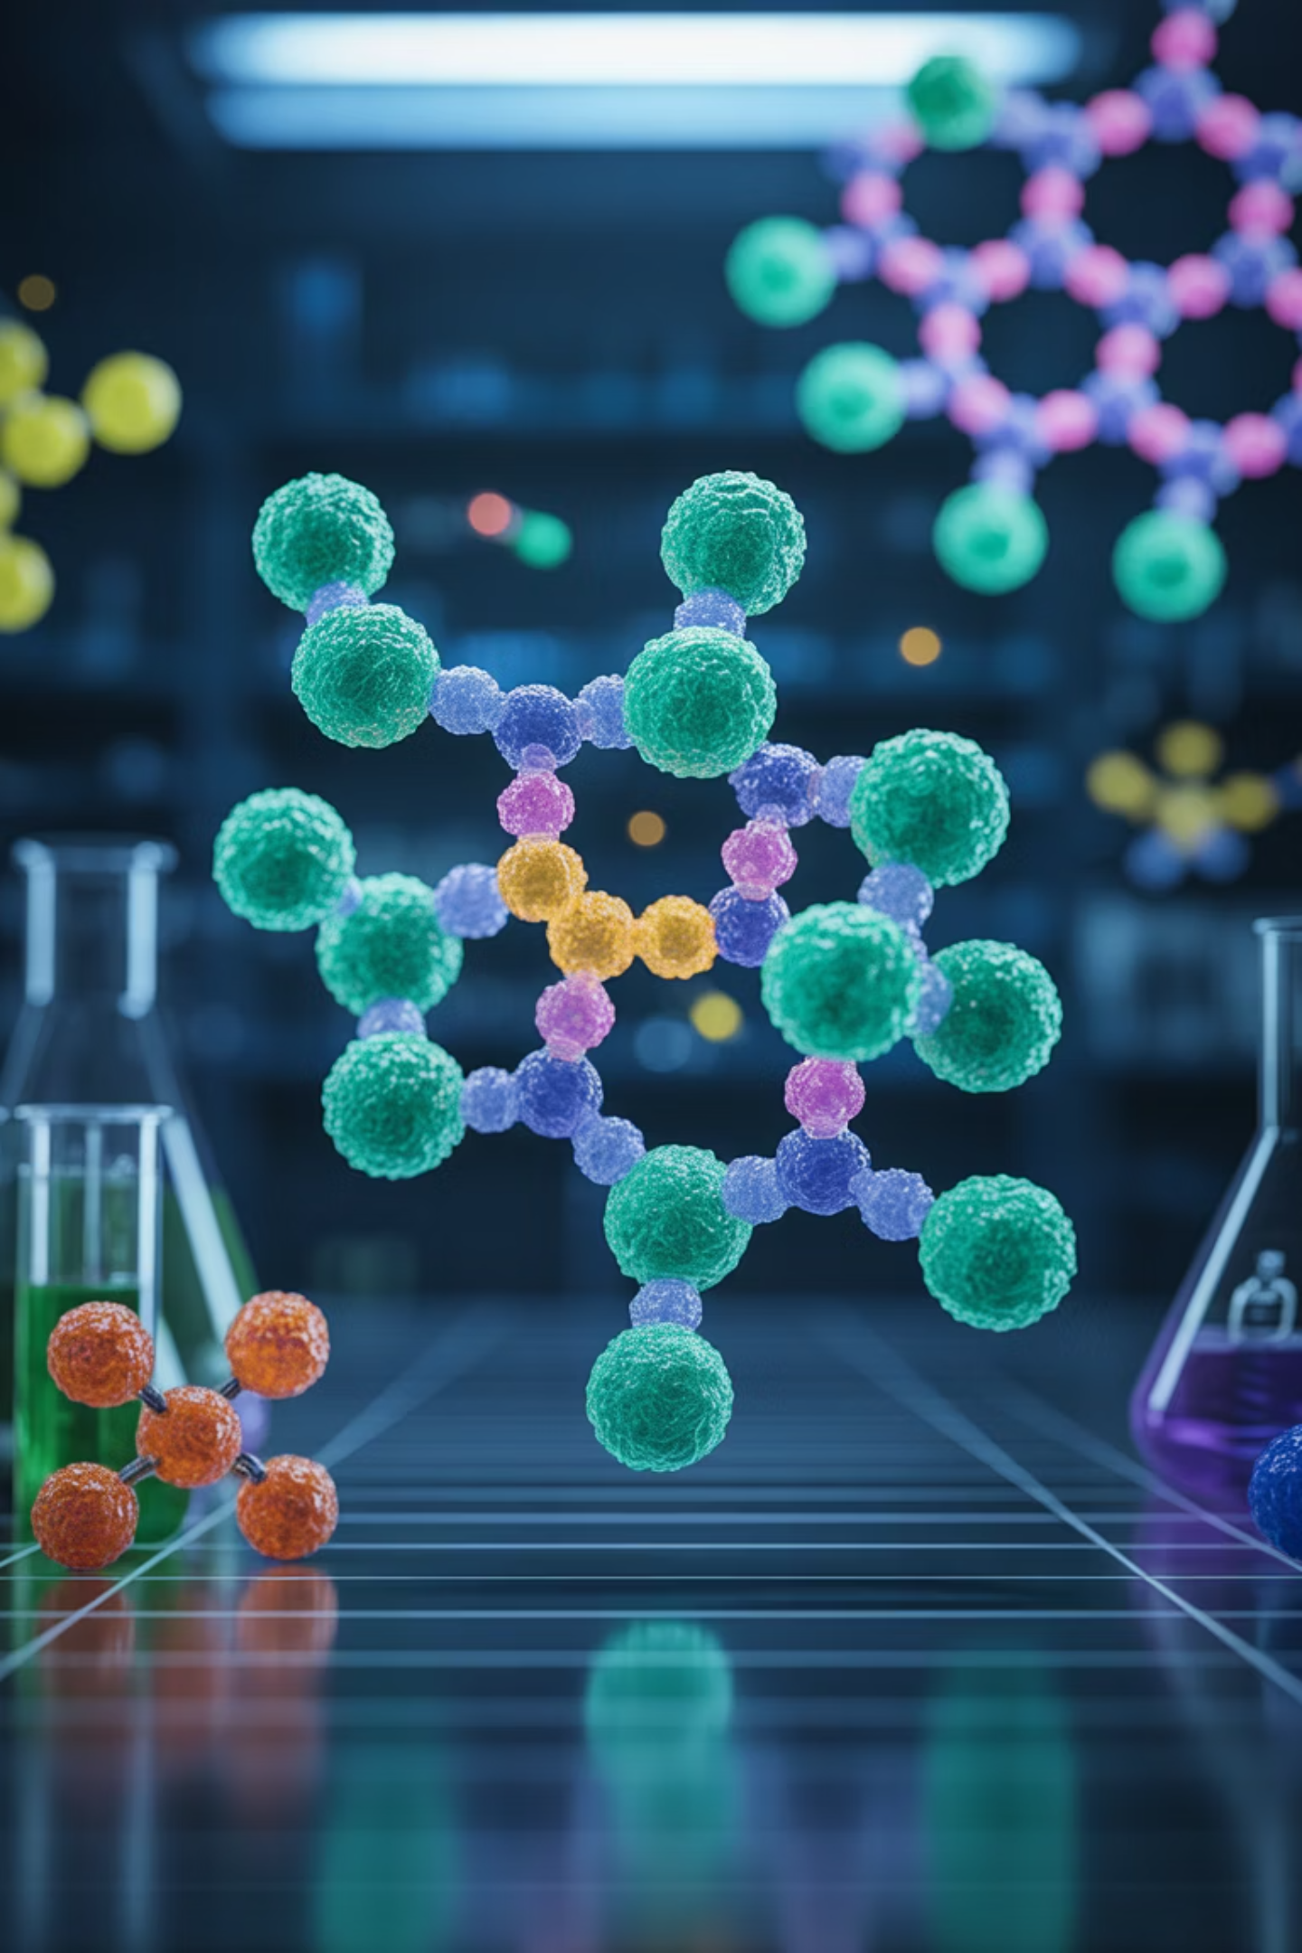
Drug Target Identification
Systems biology revolutionizes drug discovery by predicting how inhibiting a single enzyme affects the entire metabolic network. This holistic approach identifies optimal therapeutic targets while minimizing unintended side effects.
01
02
Network Analysis
Target Prediction
Map complete metabolic interactions to identify critical nodes and pathways
Simulate enzyme inhibition effects across the entire network
03
Validation
Test predictions experimentally to confirm therapeutic potential

Slide 20
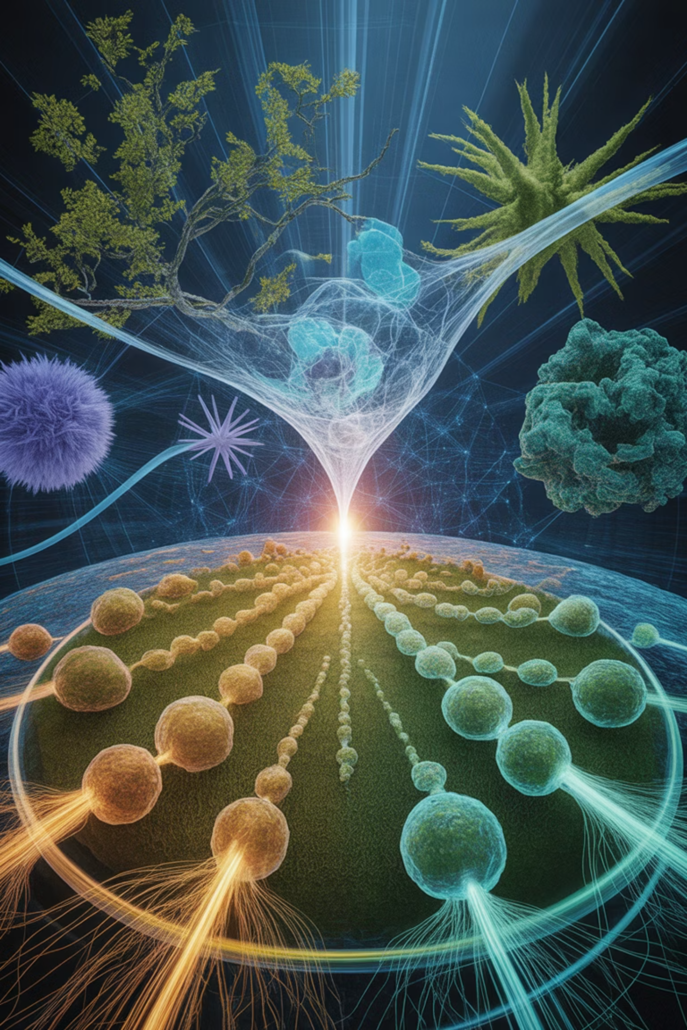
Summary: A Holistic Framework
Systems biology provides a holistic framework to study metabolic pathways, integrating omics data, mathematical models, and network theory to understand and predict cellular metabolism.
Integration
Prediction
Combines genomics, proteomics, and metabolomics into unified models
Transforms biology from descriptive to predictive science
Application
Enables drug discovery, disease modeling, and metabolic engineering
Systems biology reveals that understanding life requires seeing the forest, not just the trees – where emergent properties arise from the intricate dance of molecular interactions.

